Slide 1
GAN-LM: Generative Adversarial Network using Language Models for Downstream Applications Dae Yon Hwang, Yaroslav Nechaev, Cyprien De Lichy, Renxian Zhang
September 15, 2023

Slide 2

Meet your host
Dae Yon Hwang
Applied Scientist, Amazon Alexa AI
https://eoduself.github.io/daeyonhwang

Slide 3
Table of Contents
- Backgrounds
- Methodologies
- Experimental Setting
- Results and Discussion
- Conclusion
- Limitation
- Backgrounds
- Methodologies
- Experimental Setting
- Results and Discussion
- Conclusion
- Limitation

Slide 4
Backgrounds #1
- Large corpora and computational resources have led to development of large language models (LLMs) ubiquitous in a wide variety of tasks.
- The performance loss in no- or low-resource settings can be substantial compared to their high-resource counterparts.
- A large amount of data is important to ensure the generalization of a model but it is not always possible due to cost and time constraints or lack of target language data, experts.
- Data augmentation (DA) can be a solution which allows to artificially increase the size of a dataset which ensures the generalization of a model.

Slide 5
Backgrounds #2
- As a novel data generation, we propose Generative Adversarial Network using Language Models (GAN-LM).
- Introduce tunable thresholds and a decoding method to control the diversity and lexical similarity of synthetic data to mitigate the mode collapse problem in GAN.
- GAN-LM employs an adversarial training with the offered data in each task to learn the different characteristic which generates suitable synthetic data for each task.
- Also, we mixed GAN-LM with other DAs (e.g. Back-translation) to enhance further in low-resource languages and limited entity linking task.

Slide 6
Methodologies - Baseline #1
- Four different non-contextual-level augmentations are considered.
(1) Lexical: Use WordNet [1] to replace each word in the original text with a synonym.
(2) Spelling: Generate alternate texts from common misspellings of the original words [2].
(3) Character: Randomly change characters in the original tokens with four different ways: Insertions, substitutions, swaps and deletions [3].
(4) Token-LM: Use LM to get token for input text and then, perform nearest neighbor search for each token to find alternate tokens. BART [4] and mBART [5] are considered.
[1] Miller, George A. et al. “Introduction to WordNet: An On-line Lexical Database.” International Journal of Lexicography 3 (1990): 235-244.
[2] Coulombe, Claude. “Text Data Augmentation Made Simple By Leveraging NLP Cloud APIs.” ArXiv abs/1812.04718 (2018): n. pag.
[3] Pruthi, Danish et al. “Combating Adversarial Misspellings with Robust Word Recognition.” Annual Meeting of the Association for Computational Linguistics (2019).
[4] Lewis, Mike et al. “BART: Denoising Sequence-to-Sequence Pre-training for Natural Language Generation, Translation, and Comprehension.” Annual Meeting of the Association for Computational Linguistics (2019).
[5] Tang, Y. et al. “Multilingual Translation with Extensible Multilingual Pretraining and Finetuning.” ArXiv abs/2008.00401 (2020): n. pag.

Slide 7
Methodologies - Baseline #2
- Three different contextual-level augmentations are explored.
(1) Text Generation: Use the original text as the initial context and extend it. GPT-2 [6], OPT [7] and mGPT [8] are considered.
(2) Paraphrase: Transform a sentence with similar semantic meaning but a different syntactic form where T5 [9] and Prism model [10] are employed.
(3) Back-translation: Retranslate content from target language back to its source language to generate a sentence variant. Multiple pre-trained neural translation models are applied [11].
[6] Radford, Alec et al. “Language Models are Unsupervised Multitask Learners.” (2019).
[7] Zhang, Susan et al. “OPT: Open Pre-trained Transformer Language Models.” ArXiv abs/2205.01068 (2022): n. pag.
[8] Tan, Zhixing et al. “MSP: Multi-Stage Prompting for Making Pre-trained Language Models Better Translators.” ArXiv abs/2110.06609 (2021): n. pag.
[9] Raffel, Colin et al. “Exploring the Limits of Transfer Learning with a Unified Text-to-Text Transformer.” ArXiv abs/1910.10683 (2019): n. pag.
[10] Thompson, Brian and Matt Post. “Automatic Machine Translation Evaluation in Many Languages via Zero-Shot Paraphrasing.” ArXiv abs/2004.14564 (2020): n. pag.
[11] Helsinki-NLP. 2023. Github - helsinki-nlp/opus-mt: Open neural machine translation models and web services.

Slide 8
Methodologies - GAN-LM #1
- To extend the usability of GAN in NLP domain, we propose GAN-LM which combines GAN with pre-trained LM regardless of non-contextualized and contextualized models.
- We considered a WGAN-GP [12] which uses the Wasserstein distance as loss to capitalize on the probability distributions from fake and real data.
- Compared to the vanilla GAN, it is robust to vanishing gradient and mode collapse.
[12] Gulrajani, Ishaan et al. “Improved Training of Wasserstein GANs.” NIPS (2017).

Slide 9
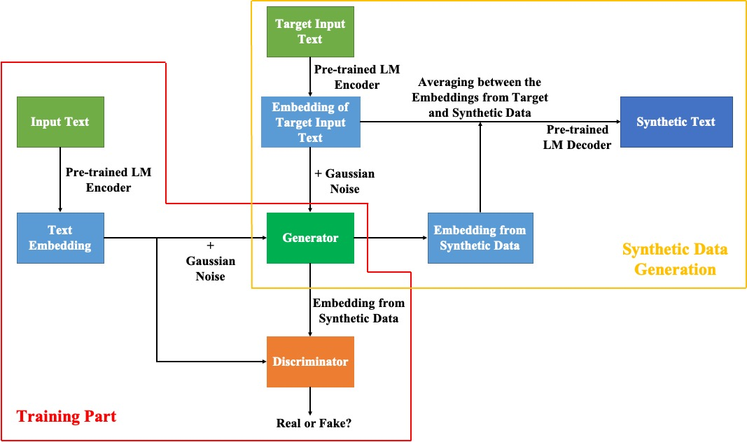
Methodologies - GAN-LM #2
Figure 1. GAN-LM with pre-trained LM.

Slide 10
Methodologies - GAN-LM #3
- In training part, we encode the input text into embeddings using pre-trained LM encoder.
- Then, we add Gaussian noise on top and input the resulting embeddings to the generator.
- Next, the generator produces synthetic embeddings which should resemble real ones.
- Lastly, we feed those to the discriminator which tries to distinguish between real and synthetic ones.
Figure 1. GAN-LM with pre-trained LM.

Slide 11
Methodologies - GAN-LM #4
- In synthetic data generation, we feed the target text to the encoder and add Gaussian noise on it.
- The generator will produce the synthetic embedding for that target text.
- Then, we average the original and synthetic embeddings to maintain the structure of original text.
- To decode, we perform nearest neighbor search for each token using generated synthetic embeddings.
- Finally, we introduce similarity thresholds to find tokens that are diverse with similar semantics.
Figure 1. GAN-LM with pre-trained LM.

Slide 12
Experimental Setting - Datasets and Employed Models
- (1) ZESHEL [13]: Zero-shot learning dataset for entity linking (EL) which is based on Wikia where there are non-overlapping domains in train/validation/test sets.
- (2) TREC [14]: Text retrieval dataset for question classification (QC) where questions were manually created with 50 fine class labels.
- (3) mSTS [15]: Multilingual version of semantic textual similarity (STS) task which has sentence pairs in 8 different languages.
[13] Logeswaran, Lajanugen et al. “Zero-Shot Entity Linking by Reading Entity Descriptions.” ArXiv abs/1906.07348 (2019): n. pag.
[14] Li, Xin and Dan Roth. “Learning Question Classifiers.” International Conference on Computational Linguistics (2002).
[15] Cer, Daniel Matthew et al. “SemEval-2017 Task 1: Semantic Textual Similarity Multilingual and Crosslingual Focused Evaluation.” International Workshop on Semantic Evaluation (2017).

Slide 13
Experimental Setting - More....
- For all downstream tasks, we construct a low-resource version (i.e. limited train set) to highlight augmentation impact.
- In EL task, ZESHEL contains rich textual context for both entity mentions and catalog entities. To isolate the impact of DA, we test model with and without those contexts.
- For EL task we used recall@k, for QC task F1 score, for STS task the spearman’s rank correlation (SRC).
- In all experiments, we retrained target model 3 times with different seeds and reported average results with 95% confidence interval (CI).

Slide 14
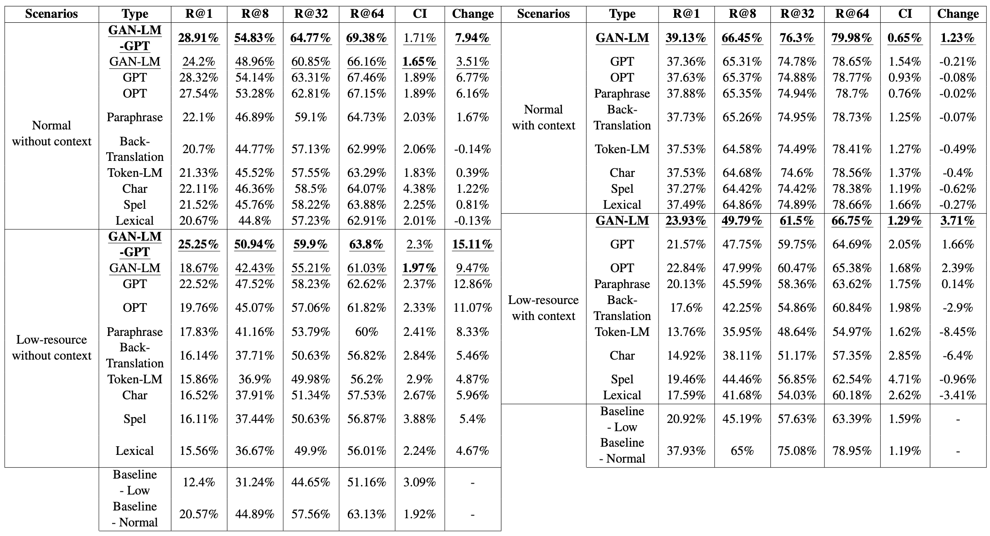
Results and Discussion - Entity Linking #1
Table 1. Recall values in ZESHEL without contexts.
- Target: Find the generalized augmentations for zero-shot learning task.
- There are large improvements, especially with contextual-level.
- GAN-LM mostly outperforms, except for GPT and OPT.
- In this case, EL model has been trained on only entity in train set to infer the entity with its contexts in test set.
- We further investigated the combination between GAN-LM and GPT, called GAN-LM-GPT.
- We observed improvements after combinations of both methods, especially in the low-resource case.

Slide 15
Results and Discussion - Entity Linking #2
Table 2. Recall values in ZESHEL with contexts.
- For scenarios with context, most augmentations decrease the performance.
- This is because synthetic data is less related to the available contexts.
- However, GAN-LM always promises the improvements.
- We observed that GAN-LM and its complement, GAN-LM-GPT, are the best choices for entity linking task.

Slide 16
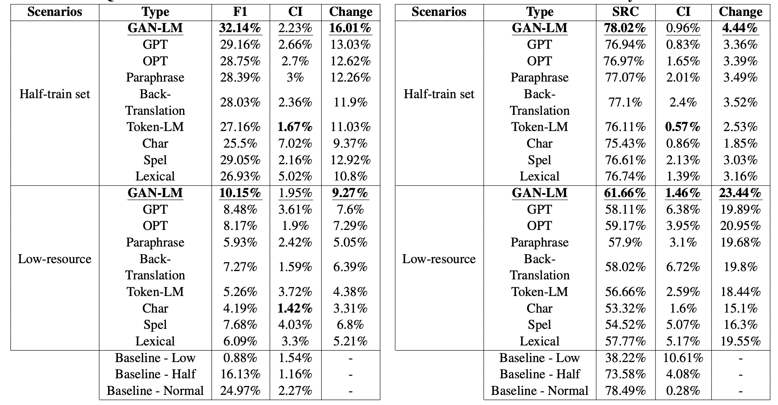
Results and Discussion - Question Classification
Table 3. F1 values in TREC.
- Target: Find label-invariant augmentations to improve the performance.
- Contextual-level augmentations mostly outperforms the non-contextual ones.
- GAN-LM is always the best performing approach which has 7.17% F1 improvement against Baseline - Normal.
Notes:
- Interestingly, improvements in half-train set are higher than the ones in the low-resource.
- This is because (1) the huge gap of performance between half-train set and normal and (2) the need of some degree of real traffic to utilize the synthetic data.

Slide 17
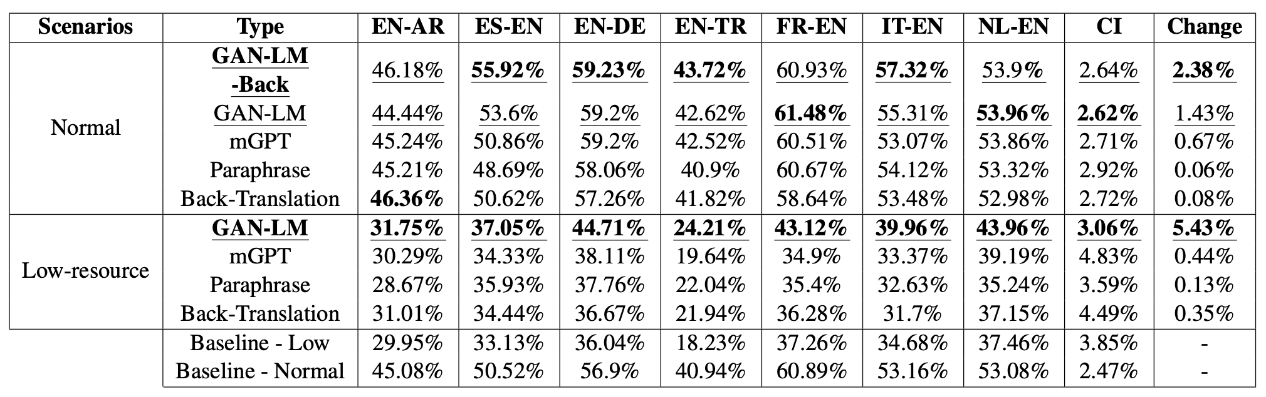
Results and Discussion - Multilingual STS #1
Table 4. SRC values in mSTS.
- Target: Find diverse and semantically consistent augmented samples in multilingual.
- In low-resource, all augmentations improve the overall performance, especially with GAN-LM.
- Improvement in normal is lower but still, GAN-LM mostly gives the best results, except for EN-AR.

Slide 18
Results and Discussion - Multilingual STS #2
Table 4. SRC values in mSTS.
- GAN-LM is mostly trained on Indo-European languages (i.e. EN, DE, NL, FR, ES, IT) which enhances the generation ability for these languages.
- Back-translation works the best in EN-AR because it directly uses the well-defined translation models and this decreases the unsuitable assigned languages (e.g. code-switching).
- We combined GAN-LM with back-translation, GAN-LM-Back, to enhance further.

Slide 19
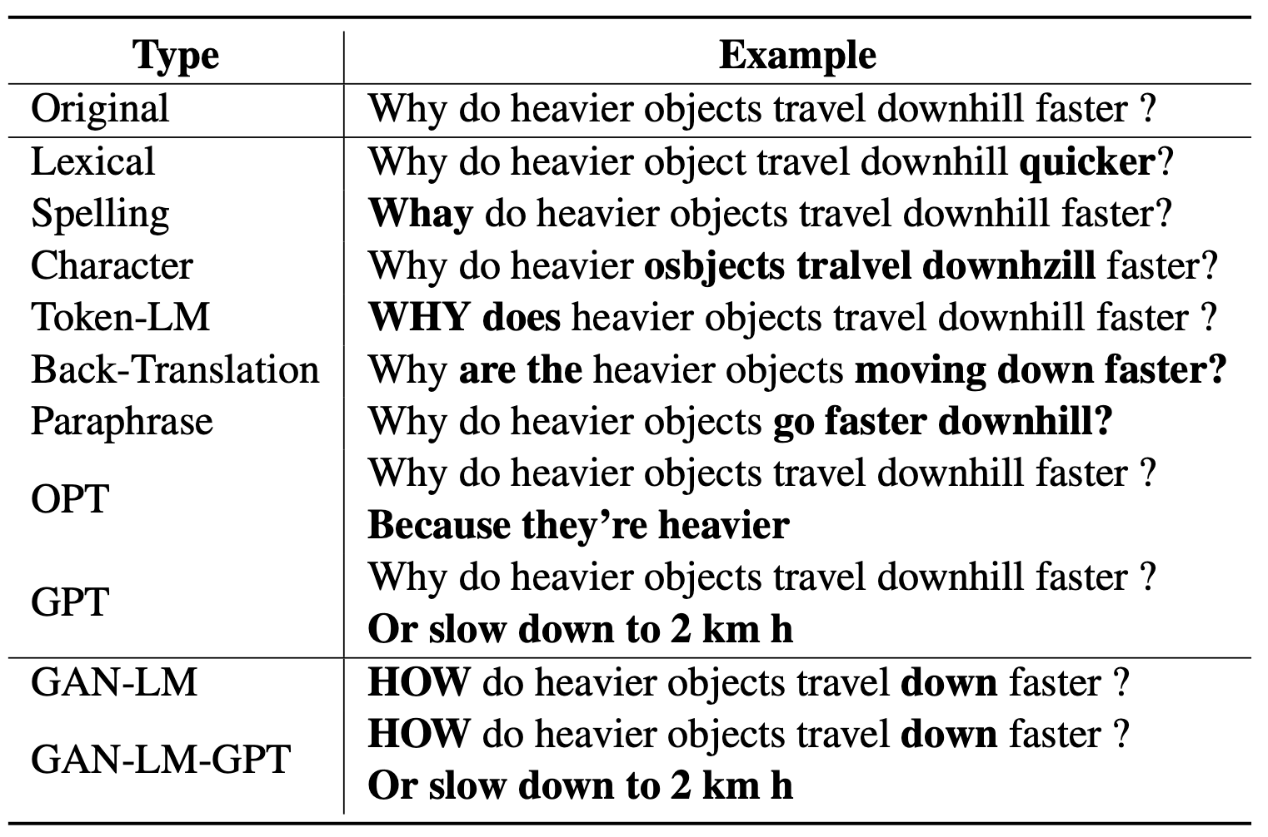
Results and Discussion – Example of Augmented Data
Table 5. Examples of generated augmentations. Bold texts in each cell mean the changed parts.

Slide 20
Conclusion
- In this work, we investigated the effect of different DAs to improve the performance on various tasks.
- We studied both techniques found in the literature as well as the proposed GAN-LM.
- We subsampled training sets to study model performance under low-resource conditions and used half or full training set to understand under different conditions.
- In most experiments, GAN-LM clearly gives the better results than non-contextual and contextual-level augmentations.
- In addition to apply GAN-LM solely, we combined it with GPT and back-translation to supplement the performance.

Slide 21
Limitation
- There are three predictable limitations in the developed GAN-LM.
- (1) The convergence of training process in GAN-LM should be investigated carefully. We may need a few iterations of training to confirm the suitable epochs for each task.
- (2) There can be a machine bias since each downstream model is trained on machine generated synthetic data. Thus, searching the suitable pre-trained model is important.
- (3) GAN-LM is a general-purpose approach and its effectiveness on specific tasks or domains may vary even if we did a thorough evaluation on four downstream tasks.

Slide 22
Thank You.

Slide 23
Related Works #1 - Appendix
- There are relatively few works using GANs for text generation even if it is one of the most notable approaches in other domains.
- GAN model with Gumbel-Softmax was developed to have a differentiable sampling distribution for approximating a categorical one *.
- GANs with recurrent and convolutional architectures were developed for text augmentation at word and character-levels **.
- Sequence GAN with reinforcement learning was suggested to address the problem of assessing a partially generated sequence ***.
* Kusner, Matt J. and José Miguel Hernández-Lobato. “GANS for Sequences of Discrete Elements with the Gumbel-softmax Distribution.” ArXiv abs/1611.04051 (2016): n. pag.
** Subramanian, Sandeep et al. “Adversarial Generation of Natural Language.” ArXiv abs/1705.10929 (2017): n. pag.
*** Yu, Lantao et al. “SeqGAN: Sequence Generative Adversarial Nets with Policy Gradient.” ArXiv abs/1609.05473 (2016): n. pag.

Slide 24
Related Works #2 - Appendix
- Sequential GAN was explored as a data generation for the bootstrapping of a new language and the handling of low-resource features *.
- As far as we know, the work in ** was the first work to consider GAN with pre-trained LM (BERT) but it was mainly for reducing the time consumption of annotating the data.
- In ***, out-of-domain data generation with a sequential GAN was suggested to build the robust dialog system.
- GAN-LM combines LLM and GAN with tunable thresholds to suitably control the diversity and similarity of generated data. This extends the applicability to various tasks.
* Golovneva, O. Yu. and Charith S. Peris. “Generative Adversarial Networks for Annotated Data Augmentation in Data Sparse NLU.” ArXiv abs/2012.05302 (2020): n. pag.
** Croce, Danilo et al. “GAN-BERT: Generative Adversarial Learning for Robust Text Classification with a Bunch of Labeled Examples.” Annual Meeting of the Association for Computational Linguistics (2020).
*** Marek, Petro et al. “OodGAN: Generative Adversarial Network for Out-of-Domain Data Generation.” ArXiv abs/2104.02484 (2021): n. pag.

Slide 25
Backgrounds - Appendix
- GAN-LM employs an adversarial training with the offered data in each task to learn the different characteristic which generates suitable synthetic data for each task.
- Even if we used pre-trained LM in GAN-LM, we do not use its generation ability (e.g. paraphrase, summarization) for downstream tasks.
- Also, we mixed GAN-LM with other DAs (e.g. Back-translation) to enhance further in low-resource languages and limited entity linking task.

Slide 26
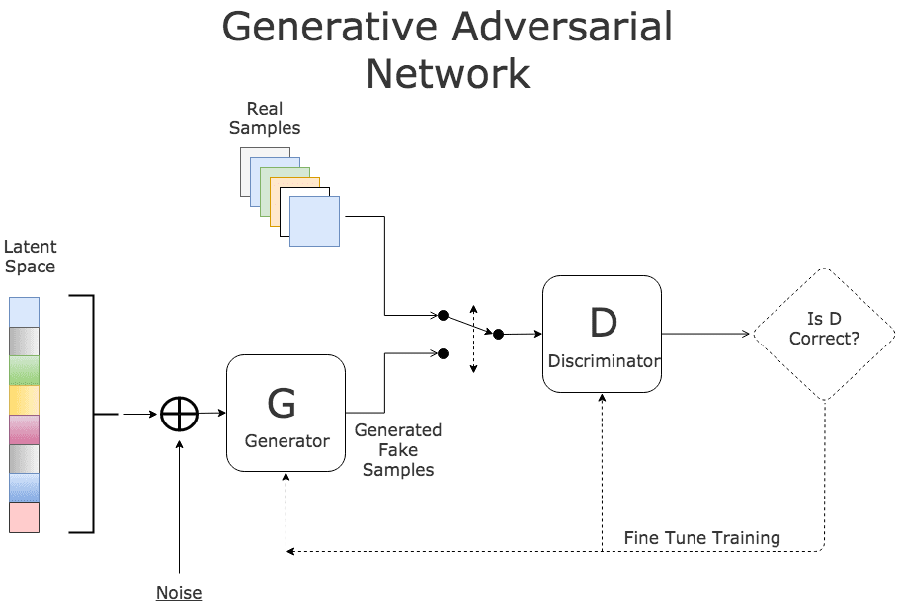
Methodologies - What is GAN? - Appendix
- Generative Adversarial Network (GAN) is based on the adversarial learning which aims to trick the model by providing deceptive input.
- It consists of two neural networks, generator and discriminator, where each of them tries to outplay the other.
- The goal of generator is to manufacture outputs that could be hard to distinguish from real data. The discriminator aims to differentiate between real and synthetic data.
https://www.kdnuggets.com/2017/01/generative-adversarial-networks-hot-topic-machine-learning.html
Figure 1. The introduction of GAN.

Slide 27
Experimental Setting - Datasets and Employed Models - Appendix
- (1) ZESHEL *: Zero-shot learning dataset for entity linking (EL) which is based on Wikia where there are non-overlapping domains in train/validation/test sets. For this, we employed BLINK ** bi-encoder model from scratch.
- (2) TREC ***: Text retrieval dataset for question classification (QC) where questions were manually created with 50 fine class labels. For this application, we used fine-tuned BERT-Tiny **** with training data in TREC.
- (3) mSTS *****: Multilingual version of semantic textual similarity (STS) task which has sentence pairs in 8 different languages. For this task, we employed the mean pooling of the pre-trained multilingual BERT (mBERT) ****** with fine-tuning from train set.
* Logeswaran, Lajanugen et al. “Zero-Shot Entity Linking by Reading Entity Descriptions.” ArXiv abs/1906.07348 (2019): n. pag.
** Wu, Ledell Yu et al. “Zero-shot Entity Linking with Dense Entity Retrieval.” ArXiv abs/1911.03814 (2019): n. pag.
*** Li, Xin and Dan Roth. “Learning Question Classifiers.” International Conference on Computational Linguistics (2002).
**** Turc, Iulia et al. “Well-Read Students Learn Better: On the Importance of Pre-training Compact Models.” arXiv: Computation and Language (2019): n. pag.
***** Cer, Daniel Matthew et al. “SemEval-2017 Task 1: Semantic Textual Similarity Multilingual and Crosslingual Focused Evaluation.” International Workshop on Semantic Evaluation (2017).
****** Devlin, Jacob et al. “BERT: Pre-training of Deep Bidirectional Transformers for Language Understanding.” ArXiv abs/1810.04805 (2019): n. pag.

Slide 28
Experimental Setting - Datasets and Employed Models - Appendix
- (3) STS-B *: Integrated version of semantic textual similarity (STS) task which includes news headlines, image captions and user forum posts.
For this task, we used SentenceTransformers ** from scratch using the mean pooling layer with the pre-trained XLM-RoBERTa ***.
- (4) mSTS *: Multilingual version of STS task which has sentence pairs in 8 different languages.
For this application, we employed the mean pooling of the pre-trained multilingual BERT (mBERT) **** with fine-tuning from train set.
* Cer, Daniel Matthew et al. “SemEval-2017 Task 1: Semantic Textual Similarity Multilingual and Crosslingual Focused Evaluation.” International Workshop on Semantic Evaluation (2017).
** Reimers, Nils and Iryna Gurevych. “Sentence-BERT: Sentence Embeddings using Siamese BERT-Networks.” Conference on Empirical Methods in Natural Language Processing (2019).
*** Conneau, Alexis et al. “Unsupervised Cross-lingual Representation Learning at Scale.” Annual Meeting of the Association for Computational Linguistics (2019).
**** Devlin, Jacob et al. “BERT: Pre-training of Deep Bidirectional Transformers for Language Understanding.” ArXiv abs/1810.04805 (2019): n. pag.

Slide 29
Results and Discussion - Semantic Textual Similarity - Appendix
Table 4. SRC values in STS-B.
- Target: Get various and semantically closed augmented data to improve the result.
- In low-resource, we could achieve great improvements, especially with contextual-level and GAN-LM.
- In half-train set, the improvement is smaller than the one in low-resource setting.
- Again, contextual-level outperforms non-contextual-level.
- GAN-LM yields the best performance which gives a closed performance as Baseline - Normal.

